Slide 1

Function Size Measurement (FSM) -
Software Sizing Techniques
3 days workshop
Mercedes Benz
Trainer :Hari Prasad Thapliyal
MBA, MCA, PGDOM, PGDFM, CIC, MCITP, MCTS, CSM
Mentor, Trainer & Coach - PMP, PMI-ACP, PRINCE2, Agile
[PMI-ACP : #318050]
[PMP : #1563385]
Colossal Technologies
#106, 18th Main, HAL 2nd Stage, Indiranagar
Bangalore, Karnataka 560008
http://www.colossaltechnologies.com
Content related queries please write to hari.prasad@vedavit-ps.com
'PMI-ACP', 'PMI', and 'ACP' are a registered marks of the Project Management Institute, Inc.
This presentation copy is authorized only for Mercedes Benz, Indiranagar, Bangalore workshop conducted on 05-06-07-Apr-16.
'PMI-ACP', 'PMI', and 'ACP' are a registered marks of the Project Management Institute, Inc.

Slide 2
Faculty & Participants An Introduction
Name, Role, Expectations, Hobby

Slide 3
Trainer Introduction
MCA, MBA (Operations), PGDFM, PMP, MCITP, PMI-ACP, Prince2 Practitioner and CSM
2 decades of experience in IT Delivery, Training, Consulting, Agile/Scrum. 16+ years in various IT delivery positions, 6 years as Project Management Trainer/Coach/Mentor.
Trained 3000+ leaders in India and internationally
190+ corporate or open-house trainings on PMP®, Agile Project Management, PMI-ACP®, PRINCE2, PMI-RM®, PMI-SM®, CAPM®, Microsoft Project® 2007 & 2010, Enterprise Microsoft Project Server® 2007 & 2010, AgileEVM, Earn Value Management, Function Point Estimation (FPA)
Delivered many trainings at international location for the citizen of Philippines, Singapore, Indonesia, Malaysia, Thailand, Japan
Class room training experience of around 5500+ hours
FPA counting experience of more than 30000 FP of 15+ proposals/projects
CMMI (1.1, 1.2), ISO9001:2000 initiative rollout
Ex-Vice President- Volunteer Development with PMI Chennai Chapter
Ex-Vice President- Volunteer Development with PMI Mumbai Chapter
Ex-Chair of Ethics Committee of PMI Mumbai Chapter
Member of PMI Mumbai Chapter & PMI Chennai Chapter
Member of PMI (Project Management Institute) USA

Slide 4
Welcome to the world of counting

Slide 5
My Favorite Quotes
"Not everything that can be counted counts, and …… not everything that counts can be counted." - Albert Einstein
"Work expands so as to fill the time available for its completion“ - Parkinsons Law
The same work under the same conditions will be estimated differently by ten different estimators or by one estimator at ten different times. So why to estimate!
Any project can be estimated accurately (once it's completed).
You say you have estimated without assumptions!

Slide 6
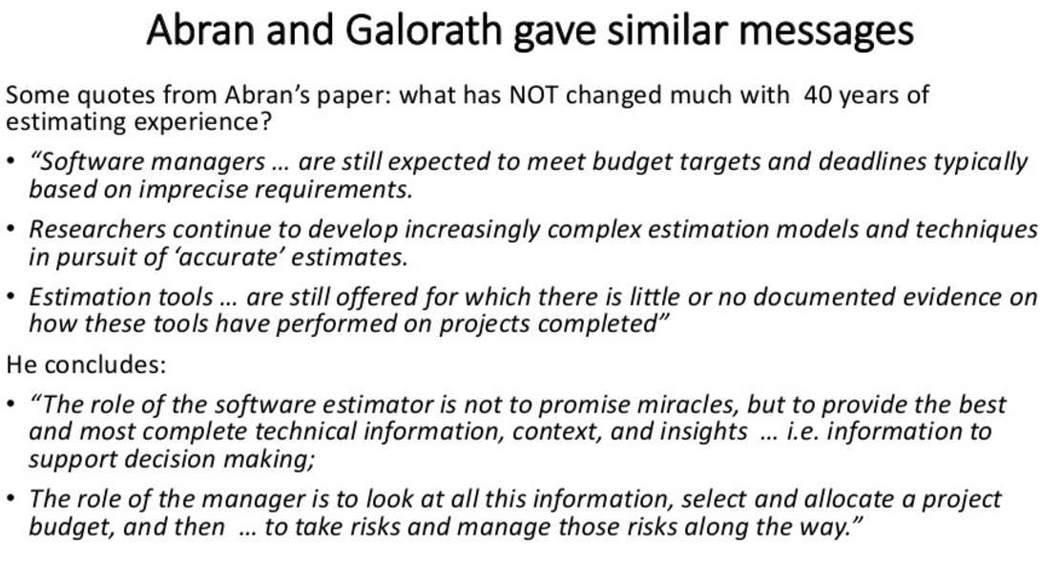

Slide 7
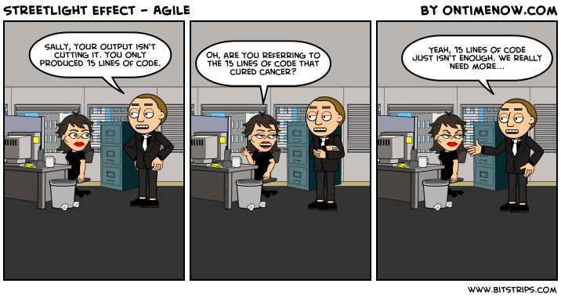

Slide 8
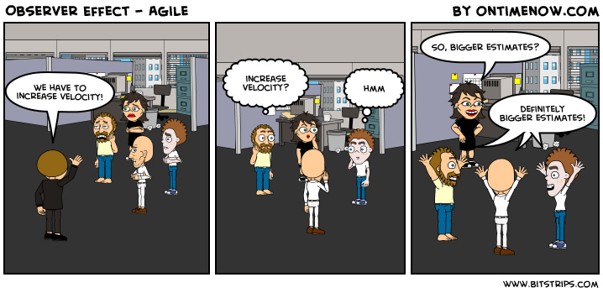

Slide 9
Working Agreements
Working Time
Break Time
Electronics
Corner Talk
Group Exercises
Participation
Our Values (for this project)
Focus
Communication
Respect
Openness
Courage
Share
Everybody
Notes:
Project Management Concepts
06/28/13
Version 3.1, 4/01 © 2003 by AstroWix
9

Slide 10
Workshop Objective
Understand Project & Project Boundaries
What to Estimate on Project?
Ranges of Estimates
Metrics, Benchmarking
Familiarity to Various Function Size Measurement Methods
Deep Dive Estimation using Function Point Analysis
Estimation using COSMIC FFP
Application of FSM in Development, Enhancement, Maintenance Projects. Agile and Traditional Project Management

Slide 11
Exclusion
In the interest of time and to learn maximum about software sizing.
Avoid deliberation on software costing and cost components, type of costs
Avoid deliberation on project scheduling techniques/ methodology/ tool
Avoid deliberation on various requirements documentation/ Business Analysis work
Avoid deliberation on various quality metrics and reporting formats.
Avoid deliberation on various estimation techniques discussed in PMBoK.
However all these topics are related to software sizing so if absolutely required we can discuss this consciously.

Slide 12
Agenda
Day 1
Introduction to Software Estimation
Understanding Elements of FPA of IFPUG
Estimating Transaction Function Types
Estimating Data Function Types
Day 2
Final Step of Size Estimation
Converting Size into Efforts
Converting efforts into Cost and Schedule
FP Thumb Rules & Metrics
Day 3
Let us Count (A case study)- FPA
COSMIC FFP

Slide 13
Lets think little more about calculation, estimation…. What we calculate or estimate.

Slide 14
Calculation vs Estimate
Calculations are always correct and accurate unless your calculator has problem ☺
Estimates are guess… based on historical data or experience
If you cannot calculate (because of any reason) you should estimate.
If you cannot estimate you cannot calculate!
Quantity of bricks / cement/ steel in this building?
What is the distance between Delhi & Bangalore?
How many electron in all the carbon atom on this planet
How much money you earned last year?
How much value you delivered in last release of your product?
What was the average speed of your friend if he reached to you within 20 min
What was the size of software your department delivered in last 5 years?
Can you calculate the speed if you know the time but not the distance?
In your house renovation work…. can you calculate effort or money if you do not know the size of work?
In software how to know size?
Calculate or Estimate?

Slide 15
How do you estimate?
How will you know these numbers? Do you estimate this?
Number of brother and sister you have
Your age
Number of uncles and aunts you have
Total of your marks in secondary school exam
No

Slide 16
Some More Questions..
Do you estimate about past?
Do you estimate about present?
Do you estimate about future?
Why do we estimate?
In what circumstances you estimate?
What do you consider when you estimate?
What do you estimate?
When do you stop estimating?

Slide 17
Estimation…
Known is counted with 100% confidence
Unknown is estimated
When time is constraint to count then you estimate

Slide 18
Importance of Size of Work
To know the cost of house you need to know “How big is the house?”
To know the cost of item you need to know “What is the weight or length of an item?”
To know the cost of travel you need to know “What is the distance between two places?”
But to know the cost knowing “Size” is not enough.
You also need to know Quality of material to be used, Quality of output defined, Performance, Reliability, Portability etc.
You should also consider Inflation, Availability of Resources
Though there are many factors (like quality, complexity, skill) that affect the cost, schedule and effort for development, size is the primary factor that helps to estimate these.
Do you measure dimension of house at the time of final handover? If yes then you should also measure size of software at the time of final handover.

Slide 19
Work Size Estimate
Work size is independent of Productivity, Availability, Efficiency and Work Calendars
Knowing size of work is first step towards planning

Slide 20
Estimate
How much time is required to go from your city to your favorite past time vacation place?

Slide 21

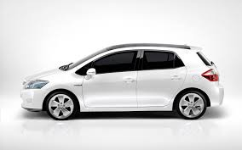
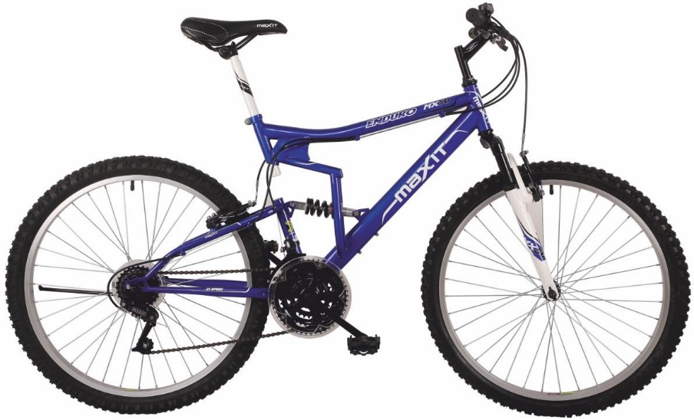

Duration Depends Upon - Mode

Slide 22



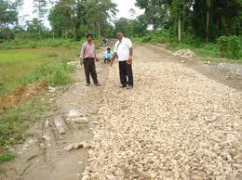

Duration Depends Upon- Roads

Slide 23
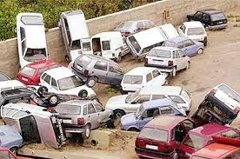
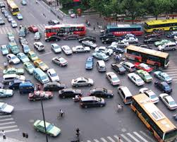
Duration Depends Upon- Traffic and Other People on Road

Slide 24



Duration Depends Upon- Driver

Slide 25

Duration Depends Upon- Distance

Slide 26
Project Duration Depends Upon
Environmental Factors (climate, politics, regulator, policies, willingness, project working time, resource availability, technology maturity)

Slide 27

How Many Candies in Jar?
What will you do to know the candies in jar without opening and physically counting them?
Factors affecting number are
Size of unseen candies
Distribution is equal in whole jar?
Is there anything else in jar
??

Slide 28
Realities of Estimation
Why we tend to underestimate?
Optimistic individuals …. a desire to please
Incomplete recall of previous experiences
Not generally familiar with the entire job to be required.
Murphy, of Murphy’s Law fame, will not work on this project.
Key estimating factors dramatically change estimates
…….

Slide 29
Schedule is Influenced By
Historical Data
Intuition
PERT (3 Points)
Delphi
Your Experience
Productivity
Time of the year
Availability
Waiting
Team Configuration
Vacations
Holidays
Work Schedule
Elapsed Time
………………

Slide 30
Availability is Influenced by
A calendar has 365 days in a year.
Weekends
Holidays
Vacations
Sickness
Training
Conferences
Snow Days
Strikes
Floods
Terrorist Activities
Election
……

Slide 31
Productivity in Influenced by
Availability is 8 Hours/day.
Bio-Breaks
Networking
Personal Phone Calls
Wasted Meeting Time
Interruptions
E-Mail, Voice, In-Box
Emotional and Physical Health Disturbances
Unrelated IMs & Chats
Travel, Elevator
Surfing, Games
…………

Slide 32
So you estimate….
Work Size
Resources
Efforts
Duration
Elapsed Time
Scheduled Time
Project Budget
Project Cost Estimates
Cost Baseline
Contingency Reserve
Management Reserve

Slide 33
A Counting Game
You´ve found a shirt for US$ 97.00.
But, you have no money, so you´ve borrowed US$ 50.00 from your mother and US$ 50.00 from your father. So:
US$ 50.00 + US$ 50.00 = US$ 100.00
You´ve bought the shirt, and there is change of US$ 3.00.
You pay US$ 1.00 back to your father, US$ 1.00 to your mother and keep the other US$ 1.00 to you.
Now you owe US$ 49.00 to you mother and US$ 49.00 to your father.
US$ 49.00 + US$ 49.00 = US$ 98.00 + your US$ 1.00 = US$ 99.00
What about the other US$ 1.00?
This is not counting But accounting problem! ☺

Slide 34
Solution of Game

Slide 35
Estimate Time
How much time is required to produce these fruits in your farm house
OR How much time is required to collect these fruits from your farm house

Slide 36
Think About This……
Can a 4,000 Hour Project be of Smaller size than One of 1,000 Hours ?
If yes, then what are the reasons?

Slide 37
Estimation Real Purpose
Outsourcing Management
Benchmarking
Measurement and Estimating Programs
CMMI Assessments
Continuous Process Improvements
………..

Slide 38
How do you Estimate?
Take your best guess and multiply by two
Take the best guess, multiple by two and raise it to the next higher unit of time
Add 54%”(An algorithmically determined fudge factor)
Ask the boss which number they want
Take the remaining time until the deadline and multiply it by the number of people on the team
Look Up
What are the advantages?

Slide 39
Guidelines for Good Estimation
Use ranges to know a confidence factor
Include basis of estimation (documented)
Perform at the appropriate level of detail
Should be performed by the person doing the work (experiential estimating)
Identify constraints and risks
Do not confuse between estimates of work and duration
Do not confuse between duration and project schedule
Considers experience and availability
Uses lessons learned at organization level
Never negotiates numbers without the basis of estimation
Project Management Body of Knowledge 5th Edition

Slide 40
Estimation Types
Estimation at Initiation Stage
Rough order of Magnitude (ROM) – [-25% - +75%]
Budget Estimate [-10% - 25%]
Estimation when Project Work or Solution Approach is known
Bottom up or Definitive Estimates. When WBS & details are available [-5% - +10%]

Slide 41
Estimation Techniques
Expert Based Techniques
Analogous Estimation
Parametric Estimation
Bottom-up Estimation
Three point Estimation
Published Data Source
Delphi Estimation
Wideband Delphi Estimation
Planning Poker

Slide 42
Estimation Techniques
Scientific Techniques
Functional Size Measurement
Function Points Analysis (FP) (by IFPUG)
Cosmic Function Points (cFP) (by COSMIC) - useful for complex real-time applications.
Feature Points – developed by Capers Jones and is an extension of FPA to count real-time applications.
FiSMA – used by Finland Software Metrics Association.
Mark II – used in United Kingdom.
Nesma – used by Nederlands Software Metrics Association.
Use Case Points (UCP)
Lines of Code (LOC)

Slide 43
Experienced based Estimation Techniques

Slide 44
Analogous Estimation
Two years ago your brother got married and he spent INR 5 lacs. Now your close friend is planning to get married and he is asking how much it will take to get married if arrangement of similar type

Slide 45
Parametric Estimating
To make 500 SF flat you need 10000 bricks. How many bricks required to make a bungalow of 2500 SF
To travel 30 km it takes one hour how much time is required to travel 250 km

Slide 46
Bottom Up Estimating
 |  | Duration | Cost ('000) | Size
Implementation |  | 64 | 440 | 210
 | HR Operations | 20 | 100 | 80
 | Payroll | 18 | 120 | 60
 | Benefits Administration | 12 | 90 | 40
 | Employee Self Service | 14 | 130 | 30
Interfaces
 | HR
 | Payroll
 | Benefits Administration
Reporting
 | HR
 | Payroll
 | Benefits Administration
Testing
 | HR
 | Payroll
 | Benefits Administration
 | Employee Self Service
Launch
 | Training
 | Change Management

Slide 47
Three Point Estimation
Optimistic
Pessimistic
Most likely
Expected Value = (O + 4xM + P) /6
Standard Deviation = (P-O)/6

Slide 48
Published Estimating Data
If you do not have experts and experience around then from where you will get data to know
How much food is required to feed all the poor of your state?
How much paint is required to paint your complete duplex home?
How much time required to get business visa of Germany?
What is productivity in Core Java Technology?
How much time is required to convert 500 GB flat file database into Oracle DB?

Slide 49
Delphi Estimates
Only experts participates in estimation processes
Estimates are anonymous
Extreme estimates are discussed

Slide 50
Summary of Estimation
Understand project boundary
Estimate size of work first
Use multiple methods for estimating
Estimation is not a one time process
Consider productivity, availability, efficiency, calendar when determining time line
Estimation of duration, timeline, cost, resource is iterative process
Maintain a repository of estimates
Automate as much as possible
Establish metrics for your organization, department and project and keep refining benchmarks
Estimation is not only science but also art because lots of imagination, creative and sometime intuitive input involved

Slide 51
Function Size Measurement (FSM)

Slide 52
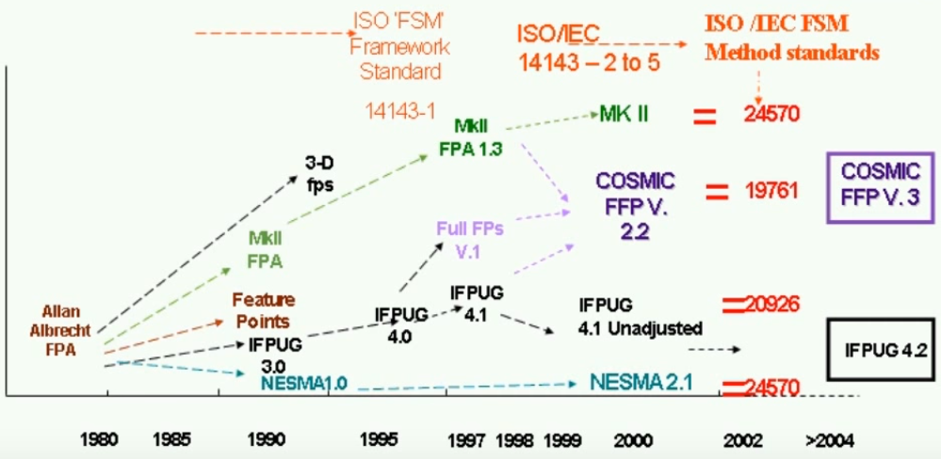
History of FSM

Slide 53
Functional Size Measurement Variants
FPA of IFPUG based on current Counting Practice Manual (CPM) 4.3.1.
IFPUG: ISO/IEC 20926:2009 Software and systems engineering - Software measurement - IFPUG functional size measurement method.
COSMIC-FFP of COSMIC: ISO/IEC 19761:2011 Software engineering.
FiSMA: ISO/IEC 29881:2008 Information technology - Software and systems engineering - FiSMA 1.1 functional size measurement method. Finnish function points
Mark-II: ISO/IEC 20968:2002 Software engineering - Ml II Function Point Analysis - Counting Practices Manual
NESMA: ISO/IEC 24570:2005 Software engineering - NESMA function size measurement method version 2.1 - Definitions and counting guidelines for the application of Function Point Analysis. Netherlands function points

Slide 54
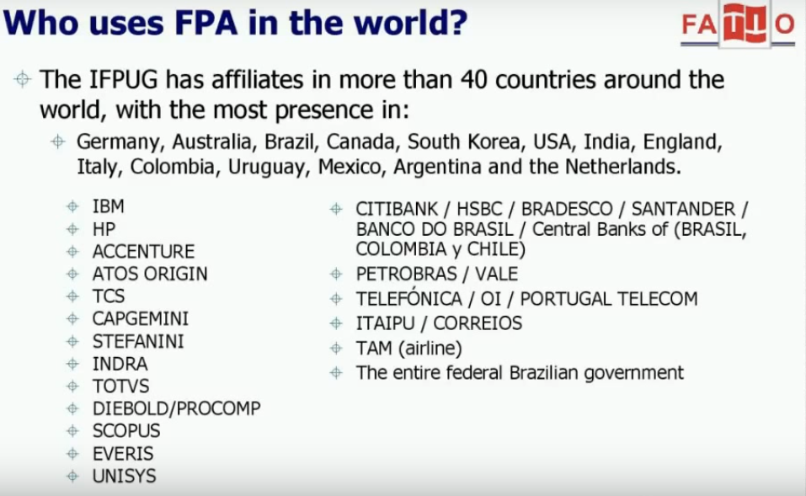

Slide 55

ISO Definitions
ISO/IEC/JTC1/SC7 Standard 14143-1(2004) Definitions:
Functional Size: A size of the software derived by quantifying the functional user requirements.
Functional Size Measurement (FSM): The process of measuring Functional Size.
FSM Method: A specific implementation of FSM defined by a set of rules, which conforms to the mandatory features o this part of ISO/IEC 14143

Slide 56
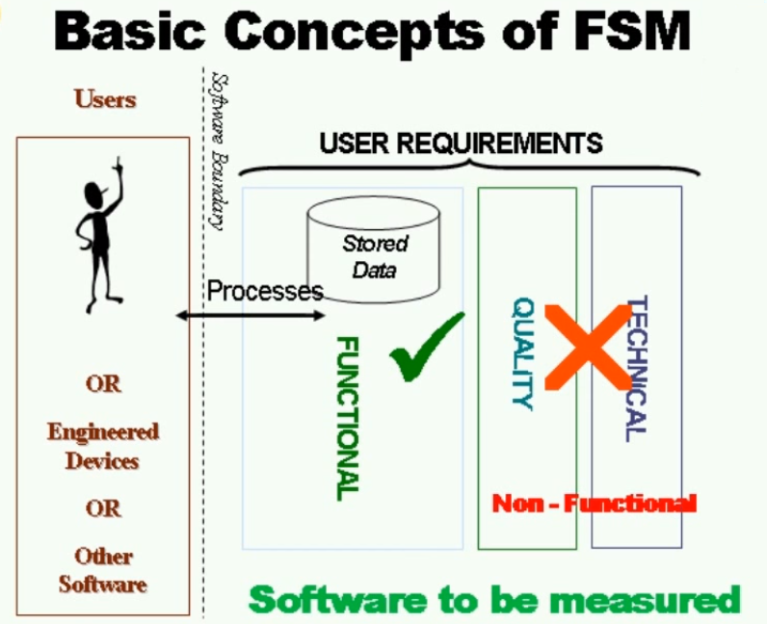

Slide 57
Functional Size Measurement
Measures Functional User Requirements
Excludes:
Physical or technical components
Quality features
Derived in terms understood by users of the software
Derived without reference to
Effort to develop or support
Methods used

Slide 58
Reality of Functional Sizing Methods (FSM)
For all current FSM methods two trained counters will achieve size figures of +/- 10 % if the user requirements are known and well specified.
if ten project managers from different business areas try to estimate project effort without a systematic approach, including FSM methods, the ratio between the smallest and biggest estimate is 1 to 6, the worst as high as 1 to 12.
Notes:
http://www.isbsg.org/ISBSGnew.nsf/WebPages/AC308EF2C87A3A2BCA25745F002CAE29

Slide 59
Function Point Analysis (IFPUG)

Slide 60
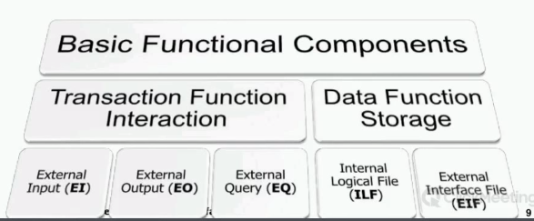

Slide 61
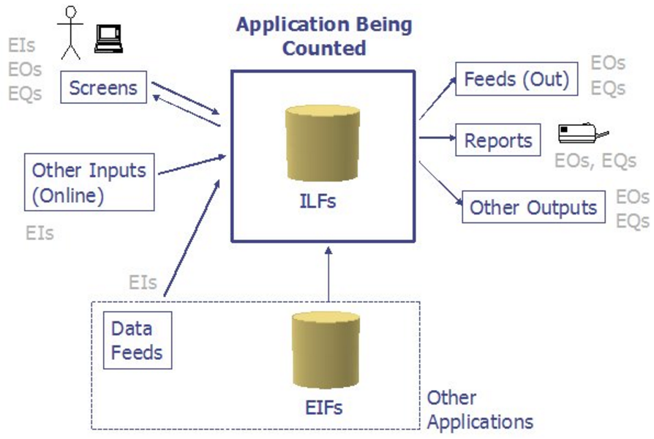
Functional Point Analysis- A Glance

Slide 62
FP Sizing is
Based on
Functional requirements as seen by the user. User functionalities
Screens
Reports
Data stores
Interfaces.
Not based on
Technical aspects of the development
Number of programs
Lines of code
Physical architecture etc.

Slide 63
FP is
FP is Repeatable and Reproducable
Provides functional and non-functional insights
Can be used in early development stages
Independent of implementation technology
Based on well defined rules so no technical skills required to count. Thus auditable.

Slide 64
Constraints of LOC
LOC is issue when more than one languages are being used
Work of architects, designers, database administrators, quality assurance, technical writers, project managers, and many other occupations cannot be counted in LOC

Slide 65
FPA : Key Terms used
Project Boundary
DET: Data Element Type
RET: Record Element Type
FTR: File Type Reference
Data Function Types
Internal Logical File (ILF)
External Interface File (EIF)
Transactional Function Types
External Input (EI)
External Output (EO)
External Query (EQ)
UFPC
AFPC
VAF
Degree of Influence

Slide 66
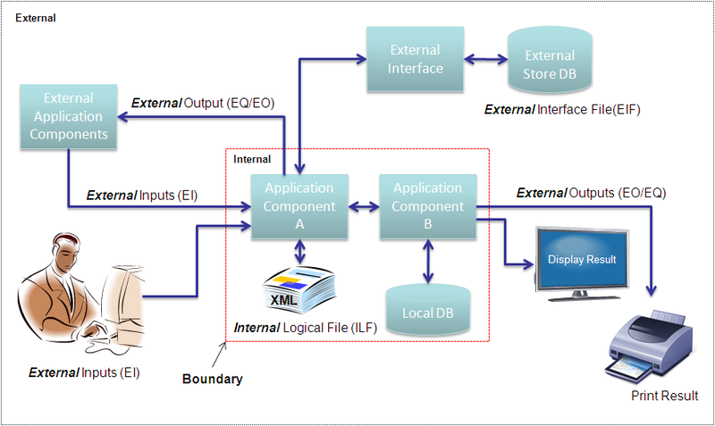
Project Boundary

Slide 67
How to calculate?
Components | Record Element Type (RET) | File Type Reference (FTR) | Data Element Type (DET)
Internal Logical Files (ILF) | . |  | .
External Interface Files (EIF) | . |  | .
External Inputs (EI) |  | . | .
External Queries (EQ) |  | . | .
External Outputs (EO) |  | . | .

Slide 68
Data Functions

Slide 69
ILF Definition
An Internal Logical File (ILF) is a user identifiable group of logically related data or control information maintained within the boundary of the application

Slide 70
Data Element Types of ILF/EIF
A data element type (DET) is a unique user recognizable, non-recursive field maintained on the Internal Logical File by the External Input

Slide 71
ILF/EIF DET Counting Rules
Count a DET for each unique user recognizable, non-repeated field maintained in or retrieved from the ILF or EIF through the execution of an elementary process
When two applications maintain and/or reference the same ILF/EIF, but each maintains/references separate DETs, count only the DETs being used by each application to size the ILF/EIF.
Count a DET for each piece of data required by the user to establish a relationship with another ILF or EIF.

Slide 72
Record Element Types
A record element type (RET) is a user recognizable subgroup of data elements within an ILF or EIF.
Optional
Mandatory
Optional subgroups are those that the user has the option of using one or none of the subgroups during an elementary process that adds or creates an instance of the data.
Mandatory subgroups are those of which the user must use at least one of the subgroups.

Slide 73
RET Counting Rules
Count a RET for each optional or mandatory subgroup of the ILF or EIF. (OR)
If there are no subgroups, count the ILF or EIF as one RET.

Slide 74
Record Element Types: Example
In a Human Resources Application, information for an employee is added by entering some general information. In addition to the general information, the employee is a salaried or hourly employee (The user has determined that an employee must be either salaried or hourly). Either type can have information about dependents. For this example, there are three subgroups or RETs as shown below:
Salaried employee (mandatory); includes general information
Hourly employee (mandatory); includes general information
Dependent (optional)

Slide 75
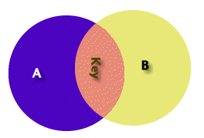
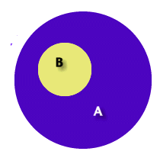
Example: RET
Some A are B – The first diagram represents two separate logical groups of data A and B (with key information between). This represents two internal logical files one RET each
All B are A – The second diagram represents one logical group of data A with two record types. B is a complete subset of A
Example – A singer gives voice to 50 different poems and creates a music album. Now if you have maintain records of CD and music in some system then you need one RET to manage Singer and his album. Second RET to manage music and related information.
Singer RET will have information (Singer, Producer, Label, Genre, Date)
Music RET will have information (Song Name, Length, Author)

Slide 76
ILF Identification Rule
The group of data or control information is logical and user identifiable.
The group of data is maintained through an elementary process within the application boundary being counted.

Slide 77
EIF Definition
An external interface file (EIF) is a user identifiable group of logically related data or control information referenced by the application, but maintained within the boundary of another application. This means an EIF counted for an application must be an ILF in another application

Slide 78
EIF Identification Rules
The group of data or control information is logical and user identifiable.
The group of data is referenced by, and external to, the application being counted.
The group of data is not maintained by the application being counted.
The group of data is maintained in an ILF of another application.

Slide 79
Elementary Processes Transaction Functions

Slide 80
Elementary Process Counting Rules
The process is the smallest unit of activity that is meaningful to the user.
The process is self-contained and leaves the business of the application in a consistent state.

Slide 81
Step to FP Counting for Each Elementary Process
Step1: Identify the Elementary Process
Step2: Determine the Primary Intent, and classify
Step3: Validate against the EI/EQ/EO Counting Rules
Setp4: Determine Complexity (Count FTR & Count DET)
Setp5: Determine the Contribution

Slide 82
File Types Referenced (FTR)
Definition
A file type referenced is
An internal logical file read or maintained by a function type
An external interface file read by a function type.

Slide 83
FTR Counting Rules
Count an FTR for each ILF maintained.
Count an FTR for each ILF or EIF read during the processing of the external input.
Count only one FTR for each ILF that is both maintained and read.

Slide 84
DET Counting Rules for Elementary Process
Count one DET for each user recognizable, non-repeated field that enters or exits the application boundary and is required to complete the external input.
Do not count fields that are retrieved or derived by the system and stored on an ILF during the elementary process if the fields did not cross the application boundary.
Count one DET for the capability to send a system response message outside the application boundary to indicate an error occurred during processing, confirm that processing is complete or verify that processing should continue.
Count one DET for the ability to specify an action to be taken even if there are multiple methods for invoking the same logical process.

Slide 85
DET Counting Rules: GUI
Radio Buttons – One DET is counted for all the radio buttons contained in the frame.
Check Boxes – Each check box, within a frame, that can be selected should be treated as a data element.
Command Buttons – According to IFPUG counting rules each command button would be counted as a data element for the action it invokes.
Display of Graphical Images or Icons – A display of a graphical image or schematic is treated as a single DET.
Sound Bytes - Sound byte is one DET.
Photographic Images – A photographic image is one DET.
Messages – Error message and Confirmation message are treated as a one DET each for the appropriate transaction.

Slide 86
DET Counting Rules: GUI
Command Buttons – Command Buttons are one DET each. Command buttons may specify an add, change, delete or inquire action. For example, a simple application to track Distributors could have fields for Distributor Name, Address, City, State, Zip, Phone Number, and Fax Number. This would represent seven data elements (7 DET’s) and the add command button would represent the 8th data element. In short, the add external input represents a one external input with eight data elements, the change external input represents another external input with eight data elements (7 fields plus the change command button), and the delete external input represents the last external input with eight data elements (7 fields plus the delete command button).
Graphic Images are one DET
Sound Bytes – This represents one data element. The number of notes played is simply recursive information. If the length of the sound byte increases, then the data element remains one. If it is played for two seconds or four seconds, then this is still one data element.

Slide 87
DET Counting Rules. GUI
Messages
Error Messages / Confirmation Messages – It indicates that a process will be or has been completed. A message, “Zip code is required” would be an example of an error message. A message, “Are you sure you want to delete the customer?” is an example of a confirmation message. Neither of these type of messages are treated as a unique External Output, but they are treated as data elements for the appropriate transaction. Each is one DET
Notification Messages – It is the basis of processing and a conclusion being drawn. For example, while withdrawing from an ATM machine more money than you have in your account. You may receive the message, “You have insufficient funds to cover this transaction.” This is the result of information being read from a file and a conclusion being drawn. A notification message is treated as an EO.
Notification Messages may be the result of processing and the actual processing or derived data my not be seen. If a message is created to be sent to a pager (beeper) at a given time. This is much like an alarm. The pager message has one data element the text message.

Slide 88
DET Counting Rules: GUI
In a GUI or OO environment it is common for information to move from one window to the next. The actual movement of data is not considered an external input because it has not crossed the application boundary (outside to inside) and does not maintain an ILF.

Slide 89
DET Counting Rules: Examples
Example: An account number that is stored in multiple fields is counted as one DET.
Example: A before or after image for a group of 10 fields maintained for audit purposes would count as one DET for the before image (all 10 fields) and as one DET for the after image (all 10 fields) for a total of 2 DETs.
Example: The result(s) of a calculation from an elementary process, such as calculated sales tax value for a customer order is counted as one DET on the customer order ILF.
Example: Accessing the price of an item which is saved to a billing file or fields such as a time stamp if required by the user(s) are counted as DETs.

Slide 90
DET Counting Rules: Examples
Example: If an employee number appears twice in an ILF or EIF as (1) the key of the employee record and (2) a foreign key in the dependent record, count the DET only once.
Example: Within an ILF or EIF, count one DET for the 12 Monthly Budget Amount fields. Count one additional field to identify the applicable month.
Example: When two applications maintain and/or reference the same ILF/EIF, but each maintains/references separate DETs, count only the DETs being used by each application to size the ILF/EIF. For example, Application A may specifically identify and use an address as: street address, city, state and zip code. Application B may see the address as one block of data without regard to individual components. Application A would count four DETs; Application B would count one DET.

Slide 91
DET Counting Rules: Examples
Example: Application X maintains and/or references an ILF that contains SSN, Name, Street Name, Mail Stop, City, State, and Zip. Application Z maintains and/or references the Name, City, and State. Application X would count seven DETs; Application Z would count three DETs.
Example: Count a DET for each piece of data required by the user to establish a relationship with another ILF or EIF. For example, in an HR application, an employee's information is maintained on an ILF. The employee’s job name is included as part of the employee's information. This DET is counted because it is required to relate an employee to a job that exists in the organization. This type of data element is referred to as a foreign key.
Example: In an object oriented (OO) application, user requires an association between object classes, which have been identified as separate ILFs. Location name is a DET in the Location EIF. The location name is required when processing employee information; consequently, it is also counted as a DET within the Employee ILF.

Slide 92
When to Count Single DETs ?
Fields that indicate an error occurred during processing or confirm that processing is complete.
Example: Error Message Fields.
Count a single DET for the capability to specify the action to be taken by the external input.
Example: count as one DET command lines or function/action (PF) keys that provide the capability to specify the action to be taken by the external input. Count this as one additional DET per external input.

Slide 93
DET Counting Rules- Real Time System
Real time and embedded systems – The time of diagnostics, hardware state during diagnostics, temperature, voltage etc. would all be examples of one DET each.
Operator Controls, Volume Controls, Sensor Readings, Radio Frequencies, Standards and Limit Settings (Alarms Settings etc.) would be counted as one DET each.

Slide 94
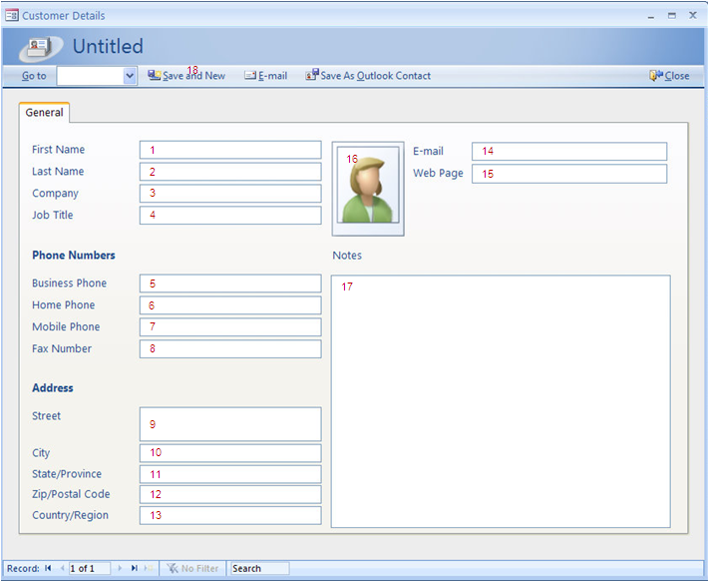
Count DET

Slide 95
EI Definition
An external input (EI) processes data or control information that comes from outside the application's boundary. The external input itself is an elementary process. The processed data maintains one or more ILFs. The processed control information may or may not maintain an ILF.
OR
External Inputs (EI) is an elementary process in which data crosses the boundary from outside to inside. This data may come from a data input screen, electronically or another application. The data can be either control information or business information. If the data is business information it is used to maintain one or more internal logical files. If the data is control information it does not have to update an internal logical file.

Slide 96
Typical Vocabulary to Identify EI
Add, Activate Amend (change and delete) Cancel Change Convert (change) Create (add) Delete Deassign Disable Disconnect (change or delete) Enable Edit (change) Insert ( add and change) Maintain (add, change, or delete) | Memorize (add) Modify (change) Override (change) Post (add, change and delete) Remove (delete) Reactivate (change) Remit Replace (change) Revise (change and delete) Save (add, change or delete) Store (add) Suspend (change or delete) Submit (add, change or delete) Update (add, change or delete) Voids (change and delete)

Slide 97
EI Counting Rules
The data or control information is received from outside the application boundary.
At least one ILF is maintained if the data entering the boundary is not control information that alters the behavior of the system.
For the identified process, one of the following three statements must apply:
Processing logic is unique from the processing logic performed by other external inputs for the application.
The set of data elements identified is different from the sets identified for other external inputs for the application.
The ILFs or EIFs referenced are different from the files referenced by other external inputs in theapplication.

Slide 98
EO Counting Rules
The function sends data or control information external to the application boundary.
For the identified process, one of the following three statements must apply:
Processing logic is unique from the processing logic performed by other external outputs or external inquiries for the application.
The set of data elements identified is different from the sets identified for other external outputs and external inquiries in the application.
The ILFs or EIFs referenced are different from the files referenced by other external outputs and external inquiries in the application.
For the identified process, one of the following three statements must apply:
The processing logic of the elementary process contains at least one mathematical formula or calculation.
The processing logic of the elementary process maintains at least one ILF.
The processing logic of the elementary process creates derived data.

Slide 99
EO Definition
An external output (EO) is an elementary process that generates data or control information sent outside the application's boundary.
OR
External Outputs (EO) is an elementary process in which derived data passes across the boundary from inside to outside. The data creates reports or output files sent to other applications. These reports and files are created from one or more internal logical files and external interface file .
Derived Data is data that is processed beyond direct retrieval and editing of information from internal logical files or external interface files. Derived data is the result of algorithms, and/or calculations. Derived data occurs when one or more data elements are combined with a formula to generate or derive an additional data element(s).

Slide 100
Typical Vocabulary to Identify EO
Browse Display Get On-lines Output Print Query | Reports Request Retrieve Seek Select View

Slide 101
DETs for Outputs
Rules
Count a DET for each user recognizable, non-recursive field that appears on the external output.
Do not count literal as DETs.
Do not count paging variables or system-generated stamps.
A logical field that is stored physically as multiple fields, but is required by the user as a single piece of information.
Each type of label and each type of numerical equivalent in a graphical output.
Text information that may be a single word, sentence, or phrase.
For example, a message is included on a report to indicate why a transaction to add a job could not be completed successfully

Slide 102
Hints for EO Counting
Is data sent outside the application boundary?
- Look at the work flow.
- Identify where the user and other application interfaces occur in the process functional decomposition.
Is the process self-contained and does it leave the business in a consistent state?
- Review external inputs and external inquiries to get an overall view of how the user works with the information.
- Work through the process diagram to get hints.
- Look at what happened in the manual system.

Slide 103
DET Counting Rules: GUI
External Outputs
Textual, graphical or electronic information
Each type of report to be treated as external outputs.
External Inquiries
Serial Inquiries to be counted separately
EQs do not contain derived data
for e.g.. customer is selective from customer list which in turn is used to extract other customer details

Slide 104
EQ Counting Rules
The function sends data or control information external to the application boundary.
For the identified process, one of the following three statements must apply:
Processing logic is unique from the processing logic performed by other external outputs or external inquiries for the application.
The set of data elements identified is different from the sets identified for other external outputs and external inquiries in the application.
The ILFs or EIFs referenced are different from the files referenced by other external outputs and external inquiries in the application.
The processing logic of the elementary process retrieves data or control information from an ILF or EIF.
The processing logic of the elementary process does not maintain an ILF.
The processing logic of the elementary process does not contain a mathematical formula or calculate
The processing logic of the elementary process does not create derived data.ion.

Slide 105
EQ Definition
An external inquiry (EQ) is an elementary process made up of an input-output combination that results in data retrieval. The output side contains no derived data. No internal logical file (ILF) is maintained during processing.
OR
External Inquiry (EQ) is an elementary process with both input and output components that result in data retrieval from one or more internal logical files and external interface files. This information is sent outside the application boundary. The input process does not update any Internal Logical Files and the output side does not contain derived data.

Slide 106
Typical Vocabulary to Identify EQ
Browse Display Extract Fetch Find Gather Get Drop Down Lists Look Ups | On-lines Output Pick Lists Print Query Scan Seek Select Show View Reports

Slide 107
Summary of Processing Logic
 | EI | EO | EQ
Validations are performed | c | c | c
Mathematical formula or calculations are performed | c | M* | X
Equivalent values are converted | c | c | c
Data is filtered and selected using specified criteria to | c | c | c
Conditions are analyzed to determine which are applicable | c | c | c
At least one ILF is updated | M* | M* | X
At least one ILF or EIF is referenced (read) | c | c | m
Data or control information is retrieved | c | c | m
Derived data is created | c | M* | X
Behaviour of the system is altered | M* | M* | X
Prepare and present information outside the boundary | c | m | m
Capability to accept data or control information that enters the application boundary | m | c | c
Resorting or rearranging a set of data | c | c | c
m it is mandatory that the function type perform the form of processing logic
M* It is mandatory that the function type perform at least one of these (m*) forms of processing logic
c the function can perform the form of processing logic, but it is not mandatory
X function cannot perform the form of processing logic

Slide 108
Abbreviations
AFP | : | Adjusted Function Point | RET | : | Record Element Type
UFP | : | Unadjusted Function Point | DET | : | Data Element Type
GSC | : | General System Characteristics | FTR | : | File Type Reference
FTR | : | File Types Referenced | GSC | : | General System Characteristic
FP | : | Function Point | VAF | : | Value Adjustment Factor
ILF | : | Internal Logical File. | LOC | : | Line of code
EIF | : | External Interface file | EAF | : | Effort Adjustment Factor
EI | : | External Inputs | SLOC | : | Source Lines of Code
EO | : | External Outputs | CPLX | : | Development/Technical Complexity Factor
EQ | : | External Enquiries | TOOL | : | Development/Technical Tool Complexity Factor
 |  |  | TDEV | : | Development Time

Slide 109
Estimation of GUI Elements

Slide 110
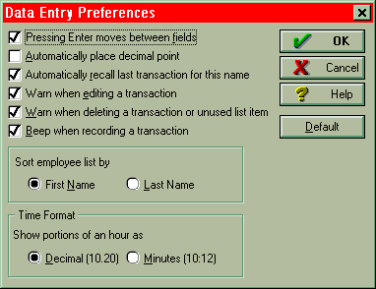
GUI Estimation: Example
Check Boxes – This may represent one data element or multiple data elements. The screen listed as Data Entry Preferences has numerous check boxes. In this case, each check box is considered a data element type (DET). Each check box is independent from other check boxes and provides different business functionality. The sort employee name and Time format are two additional data element types (DET’s) also.
How many DET’s..?
This particular screen has X data elements (Y DET’s and action key).

Slide 111
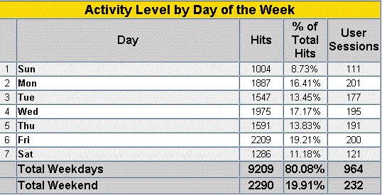
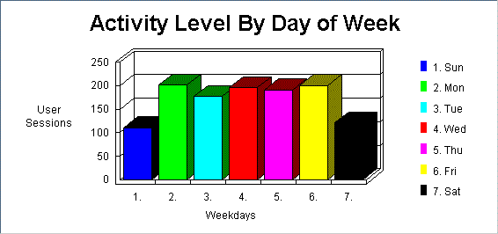
GUI Estimation: Example
There are 10 data elements in the following table
Days
Hits
% of Total Hits
User Sessions
Total Hits (weekday)
Total % (weekday)
Total User Sessions (weekday)
Total Hits (weekend)
Total % (weekend)
Total User Sessions (weekend)
One output

Slide 112
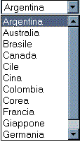
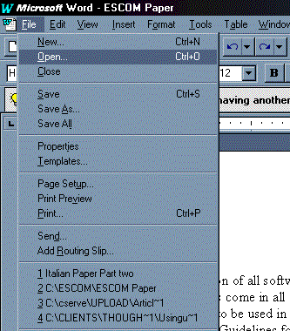
GUI Estimation: Example
Pick List – A dynamic pick list (drop down box) is an EQ if the country names are contained in an internal logical file or external interface file.
Menu – The menu displayed to the right is a dynamic menu. Word displays the last several files that have been opened. We can easily conclude that this information is being read from some type of internal file. Hence, the information is dynamic. The menu would be counted as an EQ. The real distinction is if a menu is dynamic or static. That is, are the contents of the screen or report dynamic (read from some file) or are they static.

Slide 113
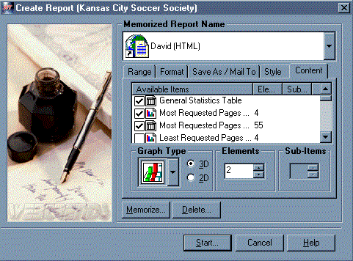
GUI Estimation: Example
It is common for GUI applications to have External Inputs preceded by serial inquiries. That is, a user may be able to select a customer name from a pick list (first EQ), the customer name is used as input for the second EQ which provides address, phone, zip and other contact information. From this point forward a user can add, change or delete the customer information (3 EI’s). In this case, this one screen would represent 2 EQ’s and 3 EI’s.
In the “Create Report” control screen, the user has the ability to select reports. This particular screen has several data elements types such as check box, graph type, dimensions, elements, sub-items and actions keys.
User can choice each report individually. In fact each report is as an object. The generated report is a combination of several reports (or objects). Each object has several attributes.

Slide 114
Value Adjustment Factor

Slide 115
General System Characteristics
F01 | Reliable back-up and recovery | Does the system require reliable backup and recovery?
F02 | Data communications | Are data communications required?
F03 | Distributed functions | Are there distributed processing functions?
F04 | Performance | Is preformance critical?
F05 | Heavily used configuration | Will the system run in an existing, heavuly utilized operational enviroment?
F06 | Online data entry | Does the system require on-line data entry?
F07 | Operational ease | Does the on-line data entry require the input transaction to be build over multiple screens or operations?
F08 | Online update | Are the master files updated online?
F09 | Complex interface | Are the input, outputs, files or inquiries complex?
F10 | Complex processing | Is the internal processing complex?
F11 | Reusability | Is the code designed to be reusable?
F12 | Installation ease | Are conversions and installation included in the design?
F13 | Multiple sites | Is the system designed for multiple installations in different organizations?
F14 | Facilitate change | Is the applications designed to facilitate change and ease of use?

Slide 116
Degrees of Influence
0 - Not present, or no influence
1 - Incidental influence
2 - Moderate influence
3 - Average influence
4 - Significant influence
5 - Strong influence throughout

Slide 117
Value Adjustment Factor (VAF)
VAF = SUM(GSC Weightage)
AFP = UAFP * VAF

Slide 118
Summary Table: FP Counting
Input Complexity Matrix (EI)
FTRs | 1-4 DETs | 5-15 DETs | 16+DETs |  |  | EI/EQ
0-1 | Low | Low | Average |  | Low | 3
2 | Low | Average | High |  | Average | 4
3+ | Average | High | High |  | High | 6
Output Complexity Matrix (EO/EQ)
FTRs | 1-4 DETs | 5-15 DETs | 16+DETs |  |  | EO
0-1 | Low | Low | Average |  | Low | 4
2-3 | Low | Average | High |  | Average | 5
4+ | Average | High | High |  | High | 7
File Complexity Matrix (ILF, EIF)
RETs | 1-19 DETs | 20-50 DETs | 51+ DETs |  |  | ILF | EIF
1 | Low | Low | Average |  | Low | 7 | 5
2-4 | Low | Average | High |  | Average | 10 | 7
5+ | Average | High | High |  | High | 15 | 10

Slide 119
Thumb Rule of FP Elements Identification
Data Functions
ILF : Validate any CRUD operation performed on a database, table, file or component including in memory caching within the boundary of the application.
EIF: Any operation invoked through a web services interface, or remote application interface through some middle-ware technology or remote access through various protocols. The data is stored outside the boundary in another system typically in another application server, content management system or file server but referenced and used by the application concerned.

Slide 120
Thumb Rule of FP Elements Identification
Transaction Functions
EI : User providing data in an online application form, selecting options, choices, inputs text, uploads files or feeds data into the system. An external application sends data to be stored/processed or both. Receive data from external sources as stream feeds at intervals. Receive a device event such as alarms or triggers with relevant data to be processed.
EQ
Data that is fetched from the database displayed as a result of some user action.
Data which may sent to external devices such as printers or other devices.
Data which is sent to other external applications outside the application boundary.
EO
Data that is fetched from the database displayed as a result of some user action.
Data which may sent to external devices such as printers or other devices.
Data which is sent to other external applications outside the application boundary.
The main difference of an EO from an EQ is that it may contain some mathematical equation, calculation of sum, average, count or other manipulation of data, or may create additional derived fields such as totals, subtotals, calculation of final cost and may also update the ILF to reflect the computed sum.

Slide 121
Summary - Function Point Calculation Steps
Identify and count ILF, EIF, EI , EO and EQ
For each ILF and EIF, identify the number of RETs and the number of DETs
For each EI, EO and EQ, identify the number of FTRs and DETs
Using the complexity matrices, count the number of low, average and high EI, EO, EQ, ILF and EIF items.
Compute the total unadjusted function points
Determine the values of the fourteen general system characteristics
Sum the total characteristics
Determine the total function points with the Total Function Point Formula
[0.65 + (.01 x total of General System Characteristics)] x [Unadjusted Function Point Count] = Total function points

Slide 122
DAY 2

Slide 123
New Development = (UFP + CFP) * VAF
Application Count = ADD * VAF
Enhancement = [(ADD + CHGA + CFP) * VAFA] + (DEL * VAFB)
Revised Application = [(UFPB + ADD + CHGA) - (CHGB + Del)]*VAFA
VAF = (S (DI) * .01) + .65
Where:
ADD = Added functionality
CFP = Conversion functionality
CHGA = UFP of changed functionality after enhancement
CHGB = UFP of changed functionality before enhancement
DEL = deleted functionality
DI = degree of influence of GSCs
UFP = unadjusted function point count
UFPB = application UFP before project
VAF = Value Adjustment Factor
VAFA = VAF after enhancement
VAFB = VAF before enhancement

Slide 124
Development Project Count
DFP = (UFP + CFP) * VAF
DFP is the development project function point count
UFP is the unadjusted function point count for the functions that will be available after installation
CFP is the unadjusted function points added by the conversion unadjusted function point count
VAF is the value adjustment factor
Application Count
After software installation, the application count is calculated using components of the development project count. The application function does not include any conversion functionality (CFP).
AFP = UFP * VAF
AFP is the initial application function point count.
UFP is the unadjusted function point count for the functions that will be available after installation
VAF is the value adjustment factor

Slide 125
Enhancement Project Count
The enhancement project function point calculation consists of three components of functionality:
Application functionality included in the user requirements for the project
Conversion functionality included in the user requirements for the project
Application value adjustment factor
EFP = [(ADD + CHGA + CFP) * VAFA] + (DEL* VAFB)
EFP is the enhancement project function point .
ADD is the unadjusted function point of those functions that were or will be added by the enhancement project.
CHGA is the unadjusted function point of those functions that were or will be modified by the enhancement project. This number reflects the size of the functions after the modifications.
CFP is the function point count of those functions added by the conversion
VAFA is the value adjustment factor of the application after the enhancement project is complete.
DEL is the unadjusted function point of those functions that were or will be deleted by the enhancement project.
VAFB is the value adjustment factor of the application before the enhancement project begins.
In practice:
In practice VAFA = VAFB = VAF, so the equation becomes
EFP = (ADD + CHGA + CFP+ DEL)* VAF)
Also normally CFP = 0, so the equation simplifies further
EFP = ((ADD + CHGA + DEL)* VAF)

Slide 126
Application Function Point Count After Enhancement Project Function Point Count
When an enhancement project is installed, the application function point must be updated to reflect changes in the application's functionality. Use the following formula to calculate the application function point after an enhancement project:
AFP = [(UFPB + ADD + CHGA) - (CHGB + DEL)] * VAFA
AFP is the application's adjusted function point .
UFPB is the application's unadjusted function point before the enhancement project begins.
ADD is the unadjusted function point of those functions that were added by the enhancement project.
CHGA is the unadjusted function point of those functions that were changed by the enhancement project. This number reflects the size of the functions after the changes.
CHGB is the unadjusted function point of those functions that were changed by the enhancement project. This number reflects the size of the functions before the changes were made.
DEL is the unadjusted function point of those functions that were deleted by the enhancement project.
VAFA is the value adjustment factor of the application after the enhancement project is complete.
In Practice
Normally VAFA = VAFB = VAF, so the equation can be re-arranged
AFP = (UFPB+ADD + CHGA-CHGB – DEL)* VAF
Example: An application has 100 unadjusted function points and a value adjustment factor of 1.02. An enhancement project adds 25 function points, deletes 20 function points, and changes 15 function points (in this case assume CHGB = CHGA). The new value adjustment factor is 1.05. What is the new (after the enhancement) adjusted function point count?
AFP = [(UFPB + ADD + CHGA) - (CHGB + DEL)] * VAFA
AFP = [(100+25+15)-(15+20)]* 1.05
http://www.functionpointmodeler.com/main.faces?target=function_point_analysis_tool_ifpug.html

Slide 127
How to Organize Elements
Function | Type | DET | RET/FTR | Complexity | FP
Files
Time Recording | ILF | 4 | 1 | Low | 7
Standard Working Time | ILF | 3 | 1 | Low | 7
Justification | ILF | 3 | 1 | Low | 7
Interfaces
Employee (from HR) | EIF | 3 | 1 | Low | 5
Transactions
Login | EQ | 4 | 1 | Low | 3
Time Recording
Import Time Recording data | EI | 4 | 1 | Low | 3
Register Entry/Exit | EI | 4 | 2 | Low | 3
Timesheet | EO | 10 | 4 | High | 7
Justification
Import Justification data | EI | 3 | 1 | Low | 3
List justifications | EQ | 6 | 2 | Med | 4
Add justification | EI | 5 | 2 | Med | 4
Modify justification | EI | 5 | 2 | Med | 4
Remove justification | EI | 3 | 1 | Low | 3
Check justification | EQ | 5 | 2 | Low | 3
Report justifications | EO | 8 | 4 | High | 7
Standard Working Time
Import standard working time data | EI | 3 | 1 | Low | 3
Add standard working time | EI | 4 | 2 | Low | 3
Modify standard working time | EI | 4 | 2 | Low | 3
Check standard working time | EQ | 4 | 2 | Low | 3

Slide 128
Categories of Maintenance
The Institute of Electrical and Electronics Engineers Inc. (IEEE) defined three categories of maintenance
Adaptive Maintenance: Software Maintenance performed to make a computer program usable in a changed environment. Enhancement.
May also include modification which is required to meet changing technical requirement
Corrective Maintenance: Software maintenance performed to correct faults in hardware or software
No change in functionality but fix the old problem. – No FPA
Perfective Maintenance: Software maintenance performed to improve the performance, maintainability or other attributes of a computer program
Non change in functionality, - No FPA

Slide 129
FP Calculation : Thumb Rule

Slide 130
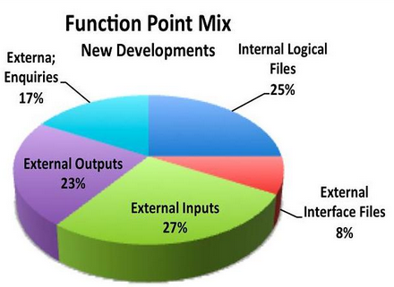
Thumb Rule for Early Prediction
Early Prediction of Functional Size from a Logical Data Model
If an application has 40 ILF
ISBSG Repository shows that most ILF are low to medium. Thus complexity attributed is 9 FP
Total ILF = 40 x 9 = 360 FP
Total App size = 360 x 4 (25%) = 1440 FP
Many organization has come up 1 ILF = 30 Something. It varies between 31-35 FP.
Notes:
http://www.isbsg.org/isbsgnew.nsf/WebPages/D9071CA94B167BA8CA257482003A36DF

Slide 131
Thumb Rule for Early Prediction
Functional Size and Duration Relationships
Project Class | Equation (Duration=) | Example (Duration) | Project Duration
3GL projects: | 0.971 * FP ^ 0.351 | Duration = 0.971* 1440^ 0.351 | 12.47 months
4GL projects: | 0.622 * FP ^ 0.405 | Duration = 0.622 * 1440 ^0.405 | 11.83 months
Application Generator | 1.472 * FP ^ 0.280 | Duration = 1.472 * 1440 ^0.280 | 11.28 months

Slide 132
Thumb Rule for Early Prediction
Work Effort and Duration Relationship
Efforts (Man-hours) = (Duration / .38)^(1/.37)
*Duration in Calendar Months
Efforts = (11.83 /.38) ^ (1/.37) = 10850 Man-hours
Project Duration = 2.5 * (Cube Root of Work Months)
If project efforts is 67 MM then
Project Duration = 2.5 * (4.1) or 10.25 months.

Slide 133
Thumb Rule for Early Prediction
Optimum Staffing Size
The origin of this formula is currently unknown, but it goes like this:
Optimum Staffing Size = Square Root of Work Months
If project effort is 67 work months then
Optimum Staffing Size = SQRT (67) = 8.1.

Slide 134
Capers Jones - Thumb Rule Approximation
Rule 1: Sizing Source Code Volumes
One function point = 125 statements for the C programming language
Rule 2: Sizing Software Plans, Specifications, and Manuals
Paper Documents (Page Count) = FP ^ 1.15 (approx.)
Rule 3: Sizing Creeping User Requirements
Creeping user requirements will grow at an average rate of 2% per month from the design through coding phases.
Rule 4: Sizing Test Case Volumes
# of Testcases = FP ^1.2 (approx.)
Rule 5: Sizing Software Defect Potentials in New Software Projects
Defect Potential = FP ^ 1.25 (approx.)
Rule 6: Sizing Defect Removal Efficiency
Each software review, inspection, or test step will find and remove 30% of the bugs that are present.
Rule 7: Estimating Software Schedules
Development Schedule (in Calendar Months) = FP ^ .4
Rule 8: Estimating Software Development Staffing Levels
Personal Required for Development = FP /150
Rule 9: Estimating Software Maintenance Staffing Levels
Personal Required for Maintenance = FP/750
Rule 10: Estimating Software Development Effort
Development Efforts (in staff months) = Duration X Number of Personal

Slide 135
Finally….
Assume a project of 1000 function points in size:
Schedule Calendar Months = 1000^.4 = 16
Staff time personnel = 1000 /150 = 6.6
Efforts (staff months to build) = 16* 6.6 =106

Slide 136
Thumb Rule for Early Prediction
1 Usecase = 35 FP. Obviously this is a very rough approximation as Use Case sizes can vary significantly.

Slide 137
Metrics

Slide 138
Average Software Defect Potentials circa 2015 for the United States
Requirements 0.75 defects per function point
Architecture 0.15 defects per function point
Design 1.05 defects per function point
Code 1.25 defects per function point
Security code flaws 0.25 security flaws per function point
Documents 0.45 defects per function point
Bad fixes 0.60 defects per function point
Totals 4.50 defects per function point

Slide 139
Use of function points
you can know productivity
you can baseline to monitor the progress
you can use it to estimate the cost of new project

Slide 140
Metrics
Productivity
Cost per FP
Number of FPs per month/week/day/hours. (productivity rate)
Number of total hours per FP. (delivery rate)
Number of developer hours per FP.
Productivity increases (or decreases) due to technology changes
Capacity = FP/ Man-month
Efforts = Size * Delivery Rate
Quality
Number of bugs/defects per FP. (Project defect rate)
Number of bug/defect fixing hours per FP.
Defect Density = Defects /FP
Scope
Requirement Stability = FP (Actual) / FP (Initial)
Backlog Size = ∑ FP (at organization level)

Slide 141
DAY 3

Slide 142
COSMIC-FFP (Common Software Measurement International Consortium Full Function Points)

Slide 143
COSMIC-FFP
FFP (Full Function Points) methods and its newest development COSMIC-FFP have been developed in order to improve the measurement of functional size for wide range of software MIS, Real-Time, Embedded and Technical.

Slide 144
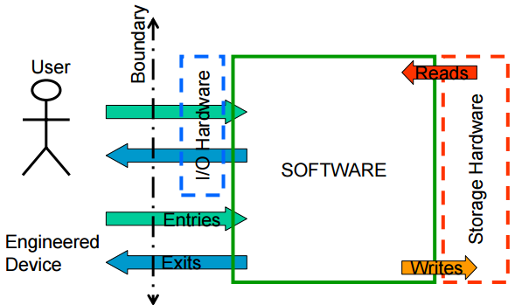
COSMIC-FFP

Slide 145
IFPUG
Input
Output
Enquiry
Stored
Data
(EIF)
Stored
Data
(ILF)
5 Base Functional Component Types (BFC Types)

Slide 146
COSMIC
Entry
Read
Write
Exit
Stored
Data
Stored
Data
4 Base Functional Component Types (BFC Types)

Slide 147
COSMIC Example

Slide 148
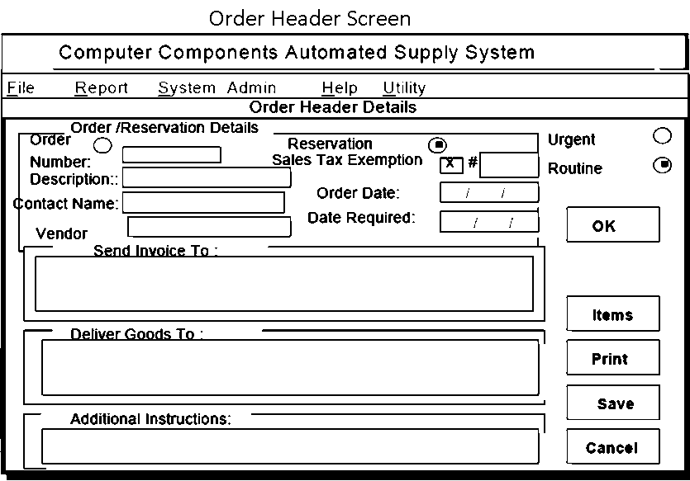
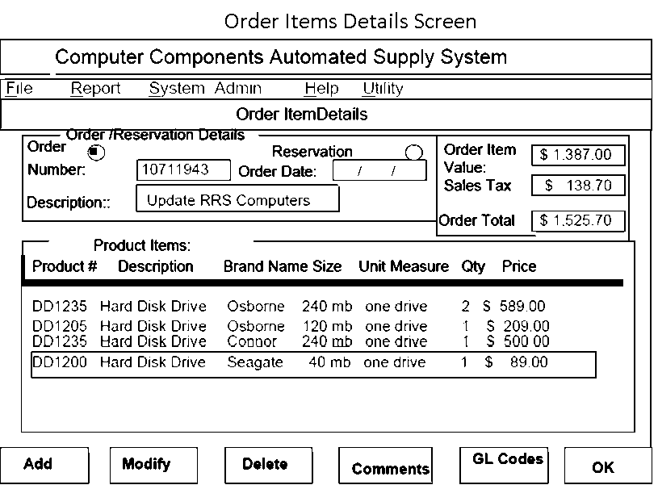
IFPUG – Logical Files
ILF
Order File (2 RET)
Order
Order Line Item
Product File
Order Template File
1 Avg, 2 Low
24 FP
EIF
General Ledger Codes File
1 Low
5FP
Data Functions: 29 FP

Slide 149
IPFUG - Transaction Functions
DET (24)
Order Type
Division Invoice Address
Reservation Number
Date Required
Additional Instructions
Order Description
Contact Name
Priority Flag
Delivery Address
Reservation Number
Order Number
Sales Tax Exception#
Order Date
Order Total
Sales Tax
GL Ref Code
Quantity
Product Code
Product Description
Item Size
Item Price
Item Order Value
Error/ Confirmation Message
Action/Control
FTR (4)
Order
Order Template
Product
General Ledger
1 EI (High)
6 FP

Slide 150
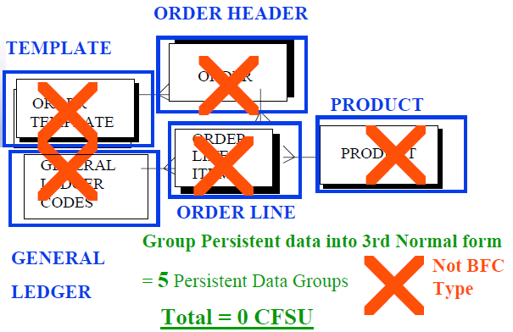
COSMIC (Persistent Data)

Slide 151
Identify READs from Persistent Data
READ General Ledger Reference Code from General Ledger
READ Product Details from Product
READ Sales Tax information from Order Template
Map data being retrieved (READ) from Persistent data to determine unique READS
3 unique READS = Total =3 CFSU

Slide 152
Identify WRITEs to Persistent Data
WRITE Order Header details to Order Header
WRITE Order Item Details to Order Line
Map data being written (WRITE) to Persistent data to determine unique WRITES
2 unique WRITE = Total =2 CFSU

Slide 153
Group Transient Data ENTERing Process
Order Header Detail Related
Order Type
Data Required
Order Description
Contact Name
Additional Instruction
Delivery Address
Priority Flag
Order Item Related
Product Code
Quantity
Map data entering to Entities
Group Data entered into get unique data movement ENTRIES
2 unique ENTRIES = Total =2 CFSU

Slide 154
Group Transient Data EXITing Process
Order Header Detail Related
Order Number.
Division Invoice Address
Sales Tax
Order Description
Order Total
Order Date
Sales Tax Exemption Number
Order Item Related
Product Description
GL Ref Code
Item Size
Unit of Measure
Price
Item Order Value
Error / Confirmation Message
Map data exiting to Entities
Group Data exiting into 3rd Normal form to get 3 unique data movement EXITS
3 unique EXITS = Total =3 CFSU

Slide 155
IFPUG & COSMIC Comparision
IFPUG | BFC Type | FP |  | COSMIC | BFC Type | CFSU
Process |  |  |  | Sub-Process
Create Order | EI | 6 |  | Enter Order Header Details | Entry | 1
 |  |  |  | Enter Order Item Details | Entry | 1
 |  |  |  | Read Product Details | Read | 1
 |  |  |  | Read Template | Read | 1
 |  |  |  | Read General Ledger | Read | 1
Order | ILF | 10 |  | Display Order Header Details | Exit | 1
Order Template | ILF | 7 |  | Display Order Item Details | Exit | 1
Product | ILF | 7 |  | Display Message | Exit | 1
General Leder | EIF | 5 |  | Write Order Header File | Write | 1
 |  |  |  | Write Order Item Details | Write | 1
Data is shared over all processes |  | 35 |  | Influence of data is incorporated into each process |  | 10

Slide 156
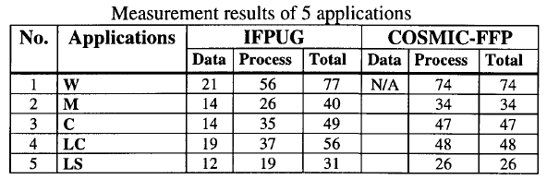
IFPUG vs COSMIC

Slide 157
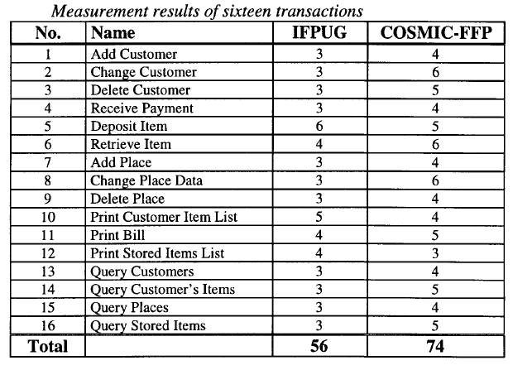
IFPUG vs COSMIC

Slide 158
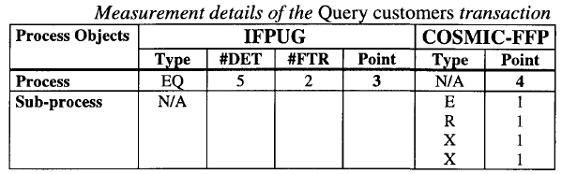
IFPUG vs COSMIC

Slide 159
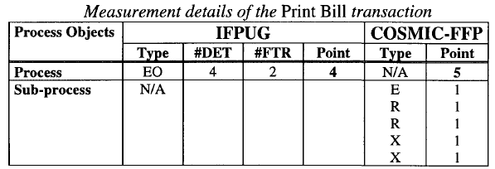
IFPUG vs COSMIC

Slide 160
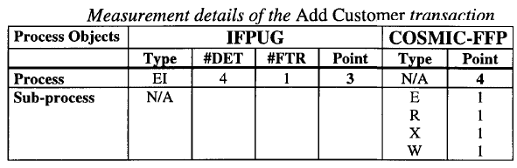
IFPUG vs COSMIC

Slide 161
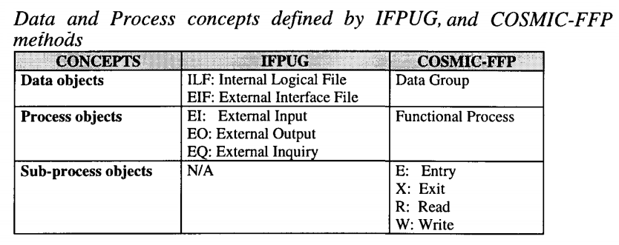

Slide 162
15 Types of Errors in Function Size Measurements
Error Category | Name
EC01 | Duplicated Functional Process (FP)
EC02 | Lack of list FP before Update FP
EC03 | Lack of List FP before Delete FP
EC04 | Lack of Retrieve FP before Update FP
EC05 | Lack of Data Movement (DM) type Write (W) in Add, Delete and Update FPs
EC06 | Redundant DM type W in list FPs
EC07 | Multiple Occurrences of the same DM with the same FP
EC08 | Each FP should be composed of at least 2 DMs
EC09 | Each FP should containt at least 1 Write (W)/ Exit (X) DM
EC10 | Each FP should contain at least 1 Entry (E) DM
EC11 | List FP Might be included in Update/Delete FP
EC12 | Create/Delete/Update Operations might be combined
EC13 | Data Group (DG) Duplication
EC14 | User Inteface Components and System Users are considered as DG/Object of Interest (OOI)
EC15 | OOI are named wrong

Slide 163
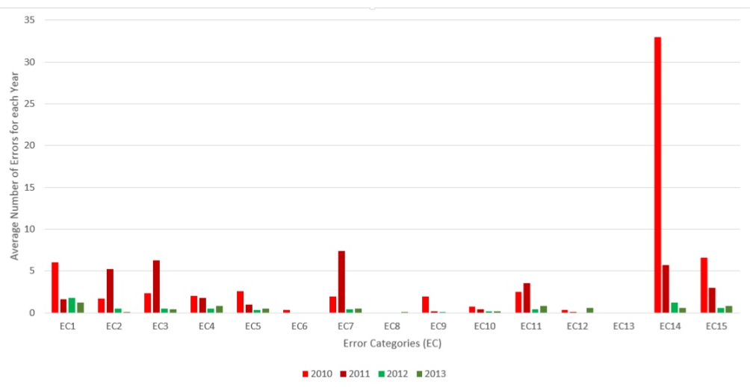
Error Categories Graphs

Slide 164
Recap
Concepts of Estimation
Earned Value Management
Forecasting
Metrics
Estimation Techniques
Function Point Analysis (FPA)
FP Calculation: Thumb Rules
Efforts , Cost & Duration Calculation
Use Case Estimation
Recap Workshop Learnings

Slide 165
References
http://www.isbsg.org/
ISBSF: International Software Benchmarking Standards Group. The Global and Independent Source of Data and Analysis for the IT Industry
http://www.ifpug.org/
International Function Point User Group
http://pmi.org/
Project Management Institute
http://www.softwaretestingclass.com/software-estimation-techniques/
Software Estimation Techniques - Common Test Estimation Techniques used in SDLC
http://www.projectmanagementguru.com/estimating.html
Project Management Estimating Tools & Techniques
Function Point Counting Practices Manual Version 4.3
Project Management Body of Knowledge 5th Edition

Slide 166

Hari P Thapliyal,
PMP, PMI-ACP, MCITP, PRINCE2 Practitioner, CSM, MBA, MCA, CIC, PGDFM
PMO Architect & Project Management Evangelist
Profile: http://in.linkedin.com/in/harithapliyal
For content related queries please contact me via
hari.Prasad@vedavit-ps.com
This document is proprietary and confidential. It remains the property of Vedavit Project Solutions at all times. No part of this document may be used, reproduced, or transmitted in any form or by any means electronic, including photocopying and recording, for any purpose without express consent of Vedavit Project Solutions.

